Slide 1

CSC 375
Project Final Report
Hungry Birds

Slide 2

CONTENTS
Project Introduction
01
Client Introduction
02
Statement of Purpose
03
Current System
04
Proposed System
05
Problem & Cautions
06
Recommendation
07

Slide 3
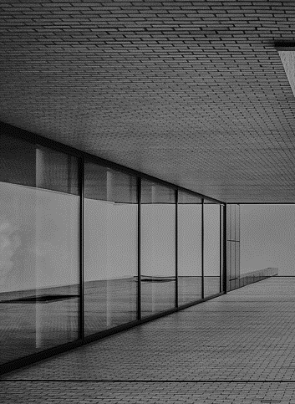
Group 11, The Hungry Birds, Members:
Nelson - Moral Support
Tariq - Document Organizer
Tom - Leading Analyzer
Wanjin - Interviewer
Chris - Website organizer
Devroop - Communications Manager
Introduction

Slide 4

Client
Introduction

Slide 5
Our Client
The UVSS Food Bank and Free Store
Alexandra, Food Bank Coordinator
Josie, Food Bank Assistant Coordinator
A Non-profit Organisation located in the basement of the SUB, aiming to provide all Uvic students with regular and reliable access to food staples and household items.
For more information, please visit UVSS website.

Slide 6
Track the total amount of food that was moving in and out of the food bank
Track number of users that are interacting with the food bank
Must be Easy to Use
Non-Profit, Must be Low Cost
1
Statement
of Purpose
2
3
4

Slide 7
Paper based
Advantages:
There is no need for any training
The only cost is printing
It provides security theatre
Unexpected deliveries are handled easily
Disadvantages:
User input is unreliable
Data can be easily lost or destroyed
Manually calculations can lead to human error
It tracks each transaction
Current
1
2
System
3
4
1
2
3
4
Notes:
1
1

Slide 8
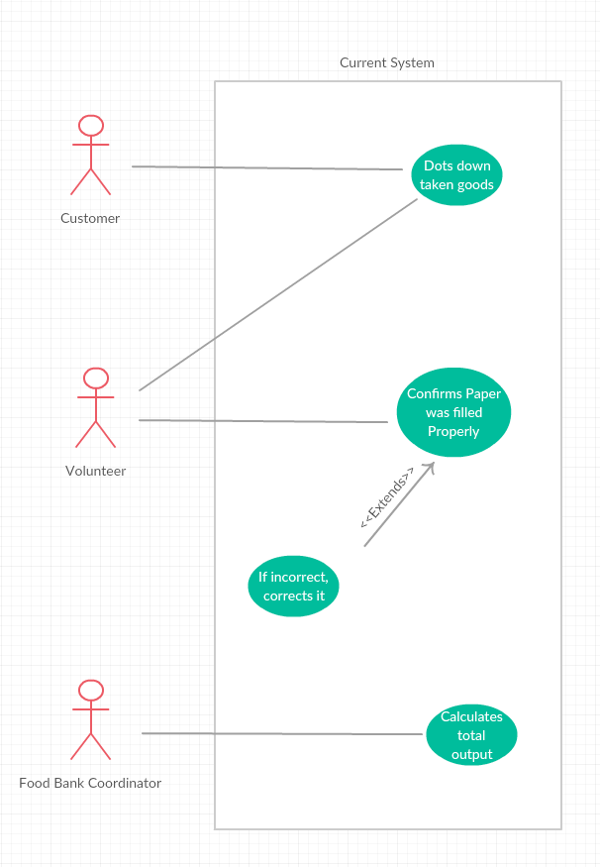
Current System Use Case Diagram

Slide 9
Problems to be Addressed
Proposed
1
Paper is too Fragile
System
2
Users don’t Record Properly
3
Room for Human Calculation Error

Slide 10
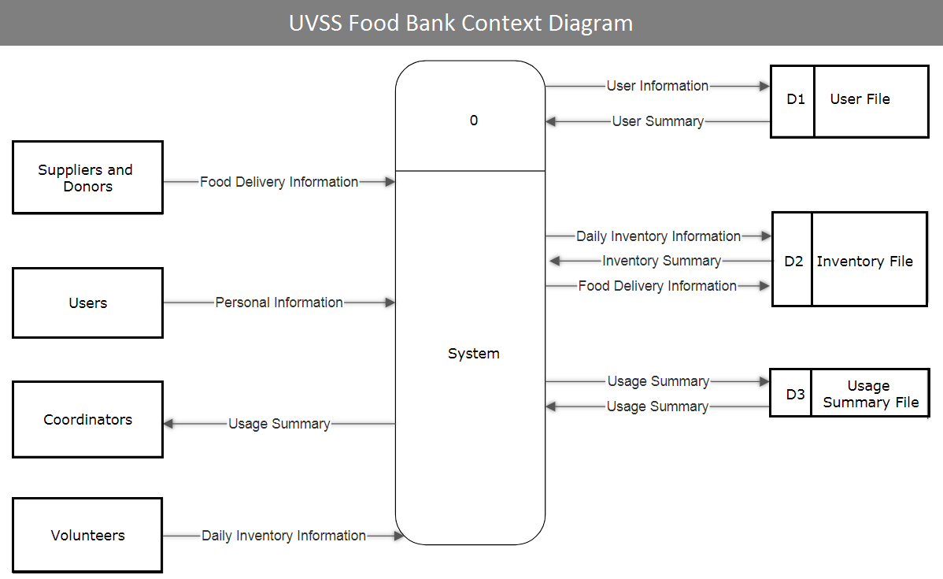
Proposed System Context Diagram

Slide 11
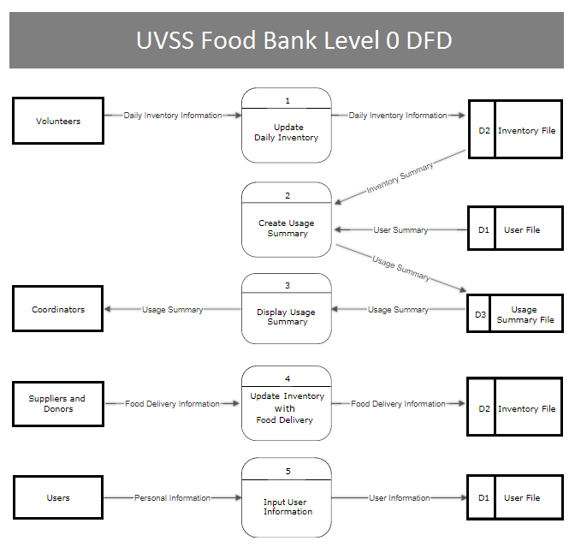
Proposed System Level 0 Diagram

Slide 12
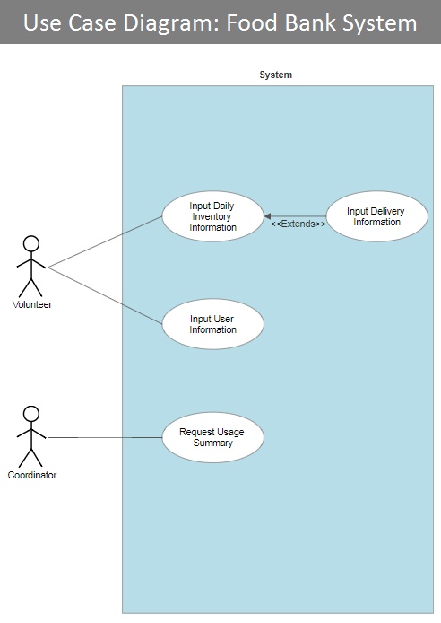
Proposed System Use Case Diagram

Slide 13
Problem &
1
Wrongly Inputted Information
Cautions
2
Software / Hardware Malfunctions
3
Invoice Handling

Slide 14
1
Give Daily Tracking Roles To Reliable Staff
Recommendation
2
Keep Software Stored Safely
3
Save Funds for Equipment
4
Store Invoices Digitally

Slide 15
Full engagement of every members
Keep the clients engaged
Don’t rely heavily others
Conclusion
1
2
3

Slide 16
Hungry Birds
Thank You
Any Questions

